Slide 1

Eye Health Station: A station with more medical insights for eye checkup
SRM INSTITUTE OF SCIENCE AND TECHNOLOGY
SCHOOL OF COMPUTING
DEPARTMENT OF COMPUTING TECHNOLOGIES
18CSP109L - MAJOR PROJECT
Guide name: DR.A.M.J.Muthukumaran
Designation: Assistant Professor Department: Computing Technologies
Batch ID: B321
Student 1 Reg. No:RA2011003010416
Student 1 Name: Kasanur Jyothiradhithya
Student 2 Reg. No:RA2011003010892
Student 2 Name: N. MD. Atahar Hajee

Slide 2
Abstract:
The Eye Health Station, a revolutionary healthcare facility, epitomizes the convergence of state-of-the-art technology and unwavering commitment to patient satisfaction.
Our primary goal is to usher in a new era of eye care by delivering precise and personalized results for an array of eye conditions. These encompass Diabetic retinopathy, Cataract, Myopia, Glaucoma, Macular degeneration, and those stemming from hypertension.
Leveraging advanced diagnostics, our station detects these conditions proactively.

Slide 3
Introduction:
Introducing the Eye Health Station, a cutting-edge healthcare facility dedicated to preserving and enhancing your vision.
The next time you go for your annual eye checkup, chances are your eye doctor will recommend retinal imaging. This is an additional eye exam that many ophthalmologists are now carrying out. This helps improve the detailed eye exam.
Retinal imaging or a retinal photograph is a surgery-free and totally safe technique of taking pictures of the back of your eye or retina. The technique allows your eye doctor to have a closer look at your retina, blood vessels, and optic nerve.
At the Eye Health Station, you're not just a patient; you're an active participant in your eye health journey.

Slide 4
Objectives:
Creating an Eye Health Station is a crucial endeavor with several key objectives.
Firstly, it aims to provide comprehensive medical insights for conditions like Diabetic retinopathy, Cataract, Myopia, Glaucoma, Macular degeneration, and those arising from hypertension.
This station will employ advanced technology to facilitate early detection, diagnosis, and monitoring of these eye conditions, ensuring timely intervention and treatment. Moreover, it will promote public awareness and education regarding eye health.

Slide 5
Literature survey:
S.No | Title | Author | Year | Methodology | Inference | Merits | Demerits
1 | Perceptions of respect from clinicians by patients in racial and ethnic minority groups with eye disease | Hicks, P. M., Elam, A. R., Woodward, M. A., Newman-Casey, P. A., Asare, A., Akrobetu, D., ... & Stagg, B. C. | 2022 | DES (Data Encryption Standard) | Supports secure data synchronization across devices | Challenges in secure data sharing with access control policies | An early symmetric encryption standard, now considered less secure due to its short key length.
2 | Digital eye strain-a comprehensive review | Kaur, K., Gurnani, B., Nayak, S., Deori, N., Kaur, S., Jethani, J., ... & Mishra, D. | 2022 | ISAP | Ensures compliance with data residency laws | Risk of data exposure during data aggregation | A lightweight authenticated encryption algorithm designed for its security and speed.

Slide 6
S.No | Title | Author | Year | Methodology | Inference | Merits | Demerits
3 | Terrestrial health applications of visual assessment technology and machine learning in spaceflight associated neuro-ocular syndrome | Ong, J., Tavakkoli, A., Zaman, N., Kamran, S. A., Waisberg, E., Gautam, N., & Lee, A. G. | 2022 | Kuznyechik | Supports secure data retention and archiving policies | Possible susceptibility to key management attacks | A symmetric block cipher developed by Russia for its use in cryptographic standards.
4 | The case for expanding visual assessments during spaceflight | Waisberg, E., Ong, J., Masalkhi, M., Zaman, N., Kamran, S. A., Sarker, P., ... & Lee, A. G. | 2023 | Chameleon | Protection against data replay attacks | Limited support for secure enclave memory protection | A symmetric encryption algorithm designed for applications requiring forward secrecy.

Slide 7
S.No | Title | Author | Year | Methodology | Inference | Merits | Demerits
5 | Virtual reality and augmented reality—emerging screening and diagnostic techniques in ophthalmology: A systematic review | Ma, M. K. I., Saha, C., Poon, S. H. L., Yiu, R. S. W., Shih, K. C., & Chan, Y. K. | 2022 | Skipjack | Prevention of data interception and eavesdropping | Risk of data exposure during encryption/decryption | A symmetric encryption algorithm used in the Clipper chip for government applications.

Slide 8
Challenges in existing system:
Traditional eye health assessments heavily rely on ophthalmologists conducting manual examinations, which can be time-intensive and may lead to long waiting times for patients.
Manual examinations are prone to human error, potentially resulting in misdiagnoses or overlooking subtle early signs of eye diseases..
Specialized eye care professionals might not be easily accessible in remote or underserved areas, causing delays in getting appointments and treatment.
Patients in rural or distant locations often face challenges in reaching eye care facilities, further exacerbating delays in diagnosis and treatment.

Slide 9
Scope and application of project:
The system incorporates advanced image analysis model VGG16, which automate the screening of retinal images.
By leveraging this AI model, the system minimizes the need for labor-intensive manual examinations, thereby speeding up the assessment process and reducing the likelihood of human errors.
The frontend interface of the system is designed to be user-friendly, enabling users to easily upload their retinal images and navigate through the assessment process without technical difficulties.

Slide 10
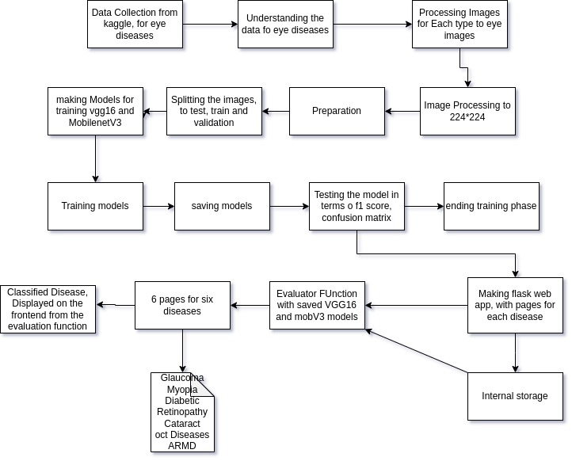
Architecture Diagram:

Slide 11
Modules description:
Data set : An image dataset is a collection of images used for training, validation, or testing in machine learning and computer vision applications.
Data Pre-processing: The goal of image preprocessing is to enhance the quality of the images, extract relevant information, and prepare them for effective and accurate processing.
Feature Extraction: Feature extraction is the process of transforming raw data into a reduced and meaningful representation of its most important characteristics for further analysis.
VGG16: VGG16 (Visual Geometry Group 16) is a convolutional neural network (CNN) architecture that gained popularity for its effectiveness in image classification tasks.
Flask: It is a micro web framework for Python that is commonly used for developing web applications.

Slide 12
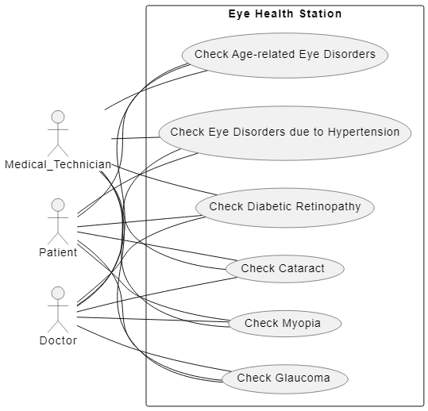
Usecase diagram:

Slide 13
VGG16:
VGG16 is a convolutional neural network architecture that gained popularity for its performance in image classification tasks.
VGG stands for Visual Geometry Group; it is a standard deep Convolutional Neural Network (CNN) architecture with multiple layers.
The architecture is characterized by its simplicity and uniformity, consisting of 16 weight layers, including 13 convolutional layers and 3 fully connected layers.

Slide 14
Layers in VGG16:
Convolutional Layers: The network consists of 13 convolutional layers. The use of small filters helps in capturing detailed information and reduces the number of parameters compared to larger filters.
Max Pooling Layers: After each set of convolutional layers, max pooling layers with 2x2 filters and a stride of 2 are applied. Max pooling helps in down-sampling the spatial dimensions, reducing computation and controlling overfitting.
Fully Connected Layers: The last three layers are fully connected layers. The first two have 4096 neurons each, and the final layer has 1000 neurons corresponding to the 1000 ImageNet classes.
Activation Function: Rectified Linear Unit (ReLU) activation functions are used throughout the network, except for the output layer, where softmax activation is used for multi-class classification.
Input Size: VGG16 accepts input images of size 224x224 pixels.

Slide 15
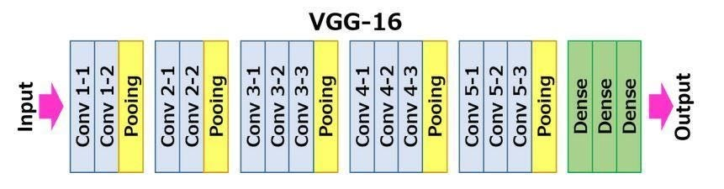
Layers in VGG16:

Slide 16
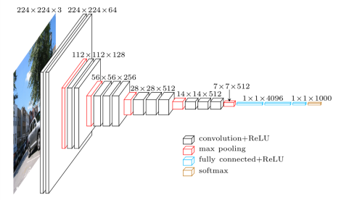
VGG16 Architecture:

Slide 17
Advantages of VGG16:
Simplicity and Uniformity: VGG16 has a simple and uniform architecture. It consists of 16 convolutional layers, followed by fully connected layers and softmax for classification. The uniformity of the architecture makes it easy to understand and implement.
Good Generalization: VGG16 performs well on a variety of image recognition tasks. Its ability to generalize across different domains and datasets makes it a versatile choice for computer vision applications.
Feature Hierarchies: The architecture of VGG16 with multiple convolutional layers allows it to capture hierarchical features in the input images. The early layers learn simple features like edges and textures, while deeper layers learn more complex and abstract features, aiding in better representation learning.
Wide Receptive Fields: Due to the use of small 3x3 convolutional filters with a stride of 1, VGG16 has a wide receptive field, which helps capture spatial hierarchies and relationships in the input images.

Slide 18
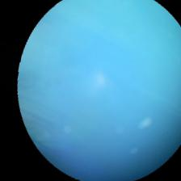
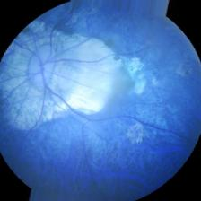
Data set:
Diseased retinal images:

Slide 19
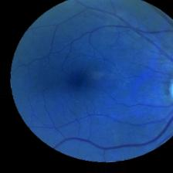
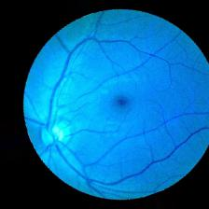
Data set:
Normal retinal images:

Slide 20
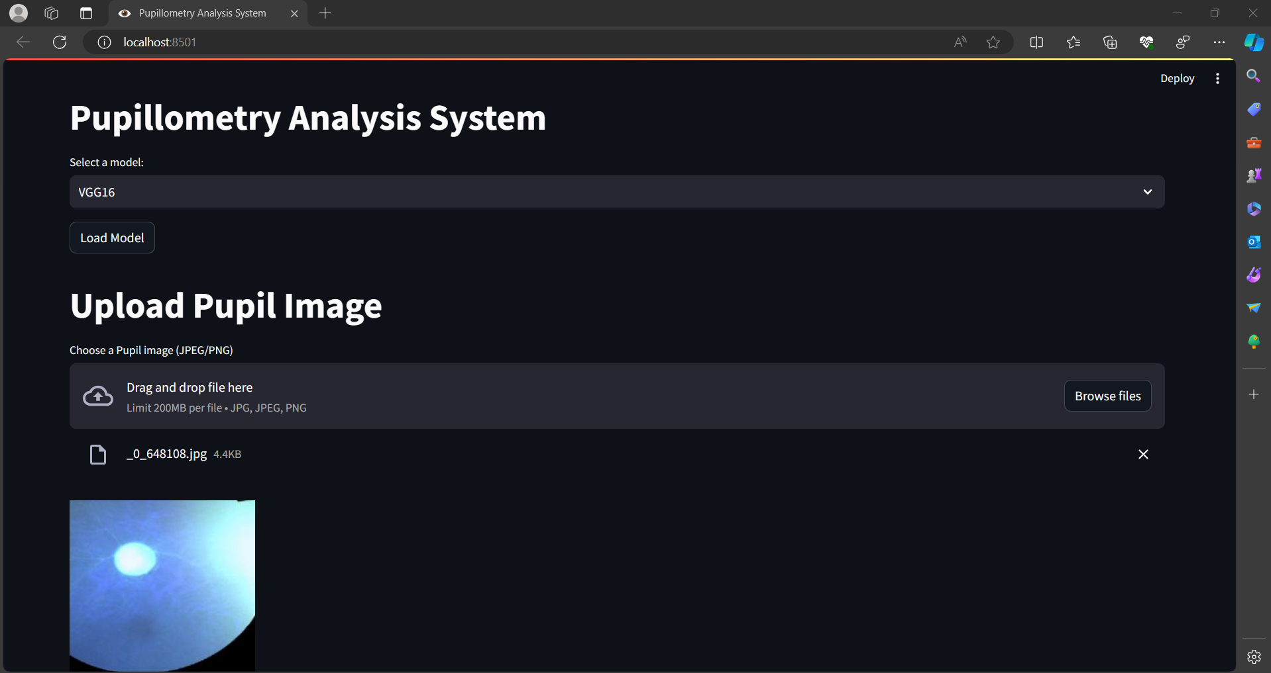
Output:

Slide 21
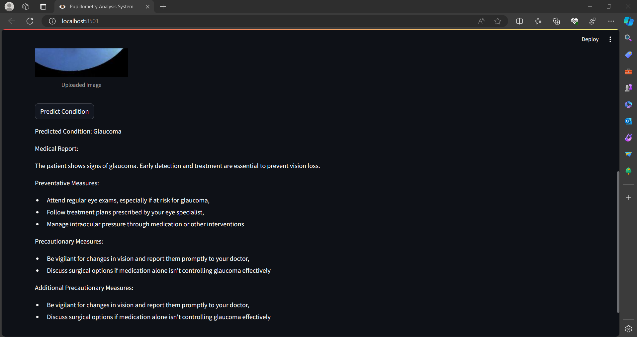
Output:

Slide 22
References:
[1] Bhikhubhai, P. F., & Sharma, P. (2019). AN INTELLIGENT SYSTEM FOR DIAGNOSIS OF VARIOUS CONDITIONS OF GLAUCOMA DISEASE IN THE FIELD OF OPHTHALMOLOGY.
[2] Okoye, R. S. (2020). Exploring public health intervention strategies to address barriers and challenges in the prevention of avoidable blindness due to glaucoma in Anambra State, Nigeria (Doctoral dissertation, Middlesex University).
[3] Hwang, P. H., Longstreth Jr, W. T., Thielke, S. M., Francis, C. E., Carone, M., Kuller, L. H., & Fitzpatrick, A. L. (2021). Ophthalmic conditions associated with dementia risk: The Cardiovascular Health Study. Alzheimer's & Dementia, 17(9), 1442-1451.
[4] Sukha, A. Y. (2014). Demographic, medical and visual aspects of diabetic retinopathy and diabetic macular edema. University of Johannesburg (South Africa).
[5] Richter, G. M., Choudhury, F., Torres, M., Azen, S. P., Varma, R., & Los Angeles Latino Eye Study Group. (2012). Risk factors for incident cortical, nuclear, posterior subcapsular, and mixed lens opacities: the Los Angeles Latino eye study. Ophthalmology, 119(10), 2040- 2047.

